Slide 1
Programming Assignment 1 A Quick Guide
Dr. Myounggyu Won

Slide 2
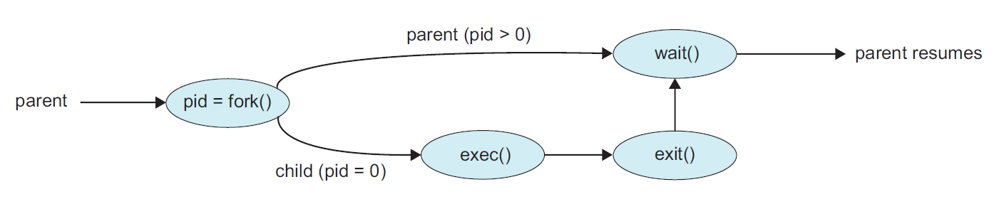
Getting Started
Your shell launches a program by creating a new process and executes it by replacing the memory space of the new process with the program.
User command (program + arguments)
(Shell)
Replace the current process’s memory space
with the program specified by the user input.

Slide 3
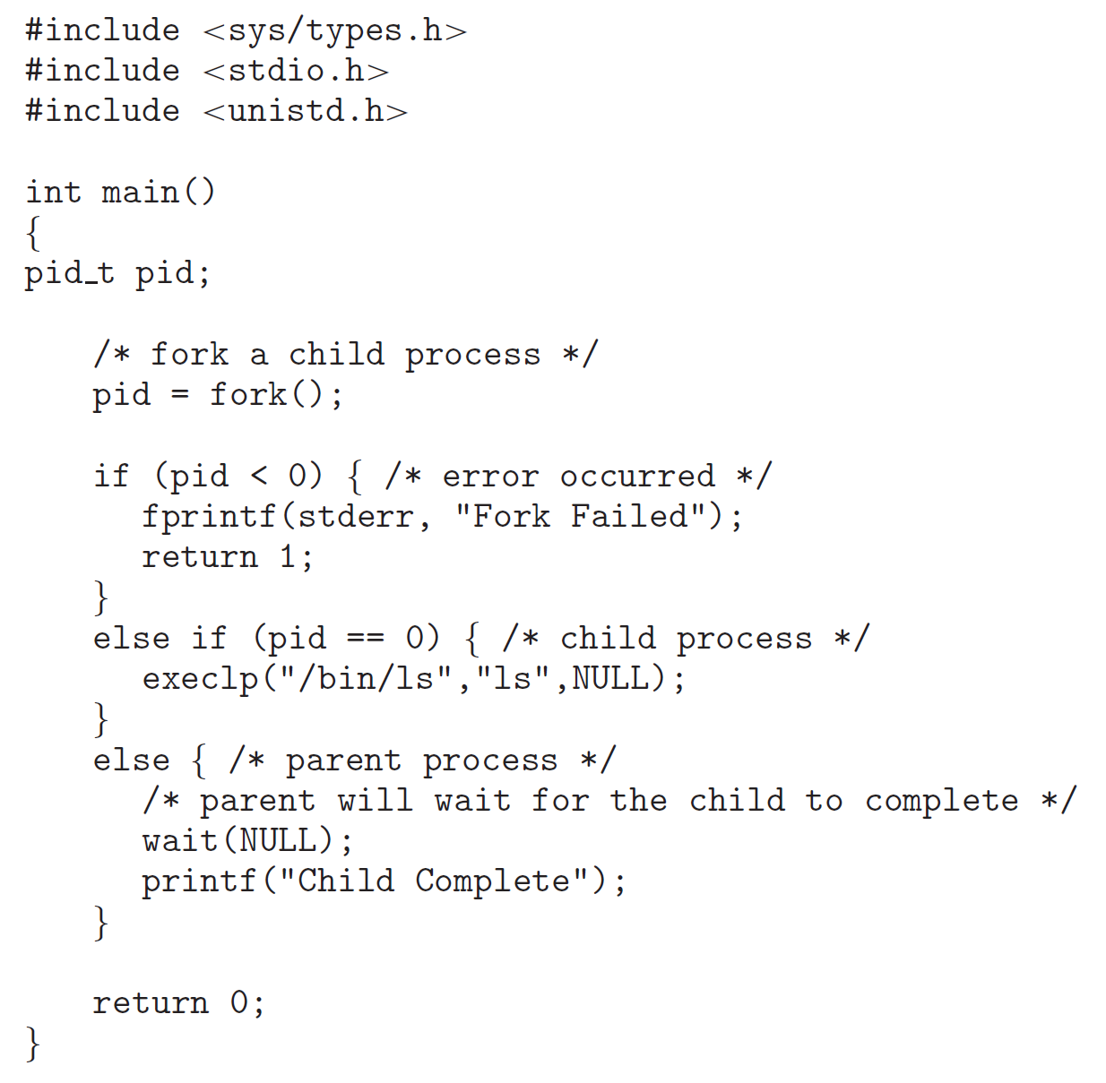

Slide 4
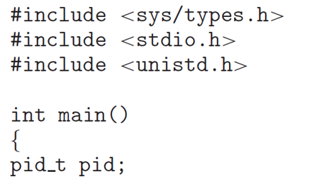
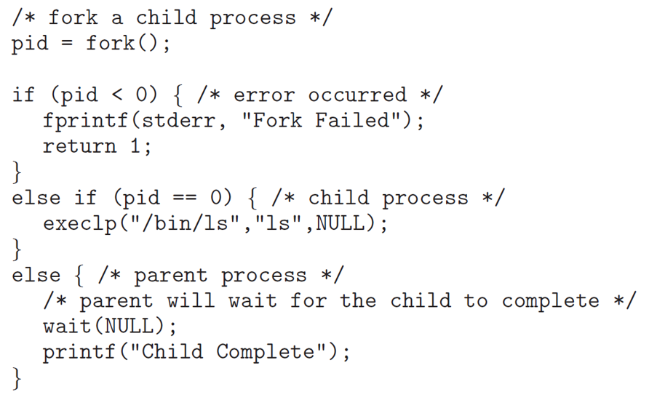
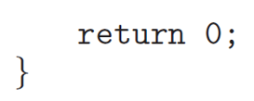
While (…) {
// take user input, and parse the user input into a program and argument(s)
// built-in command? [Subtask 1]
// process the ‘cd’ command + arguments (e.g., ‘-’, ‘.’, etc.) [Subtask 3]
// process the user command using fork() + exec() [Subtask 2, 4]
Prog
Args
How do you handle an
arbitrary number of arguments?
``
}

